Slide 1
course instructor: sir minhal raza Ds project: Snake game
GROUP MEMBERS:
MEHRIIN SHEIKH 11407
MAHADEV KHATRI 11310
HARIS AHMED 11269

Slide 2
INTRODUCTION
In the game of Snake, the player uses the arrow keys to move a "snake" around the board. As the snake finds food, it eats the food, and thereby grows larger. The game ends when the snake either moves off the screen or moves into itself. The goal is to make the snake as large as possible before that happens

Slide 3
DESCRIPTION
In this game you first have to start the game you will find a circle and a static red circle which is snake’s food. By the moving the red circle you have to pass the snake. If you do this then you will get a one point and another static red circle generated at another location. And you have to repeat it again. To win this game you have to get max points. You can control the snake by up, down, left and right arrow. If moving snake touches the boundary then your game will be over so be careful about that. You can restart the game by clicking on restart. When you play the game the next time it starts from the start. All these things are managed by your profile. Here, no concept of database. It handles the profile just from the simple text files.

Slide 4
IMPLEMENTATION
We have added the GUI components for this game.
We have added the events for this game.
We have created 3 external classes Settings, Input and Circle.
We added custom events to the Form1.CS file.
We have created custom functions eat(), die(), movePlayer(), generateFood() and startGame().

Slide 5
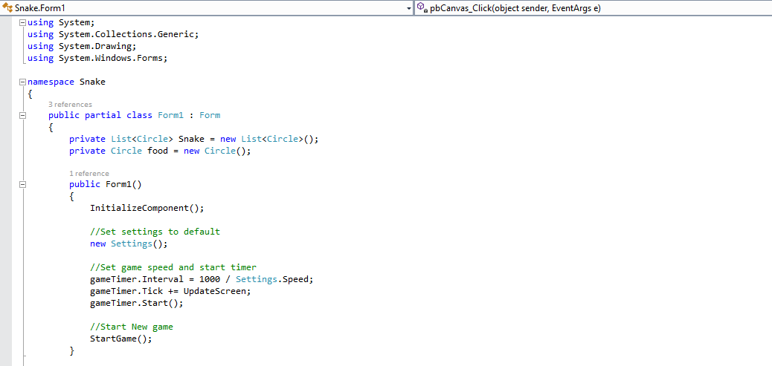
SOURCE CODE

Slide 6
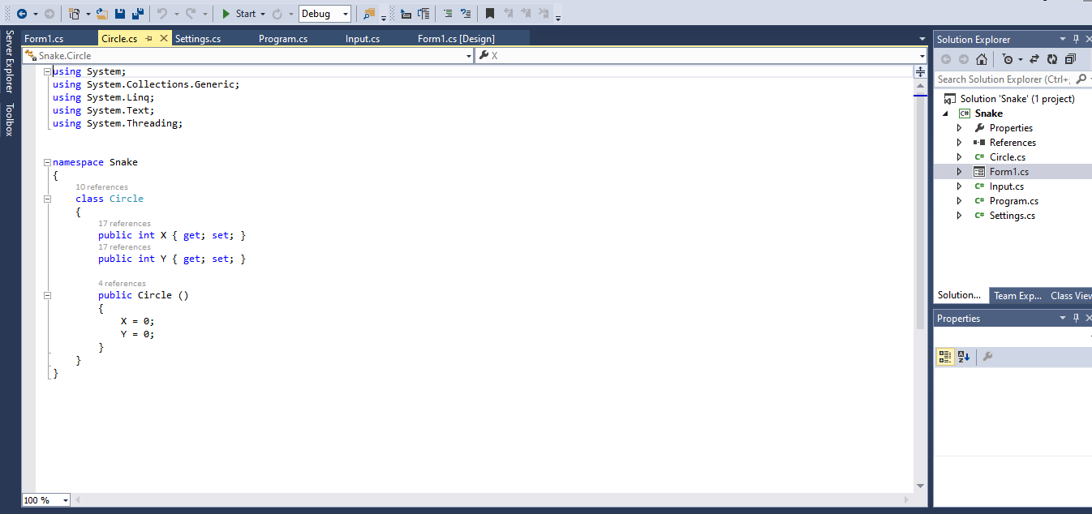

Slide 7
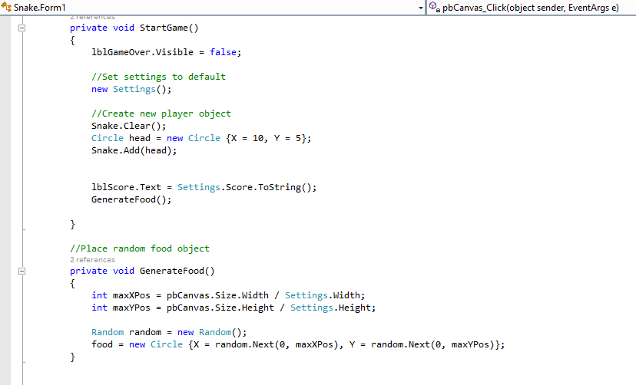

Slide 8
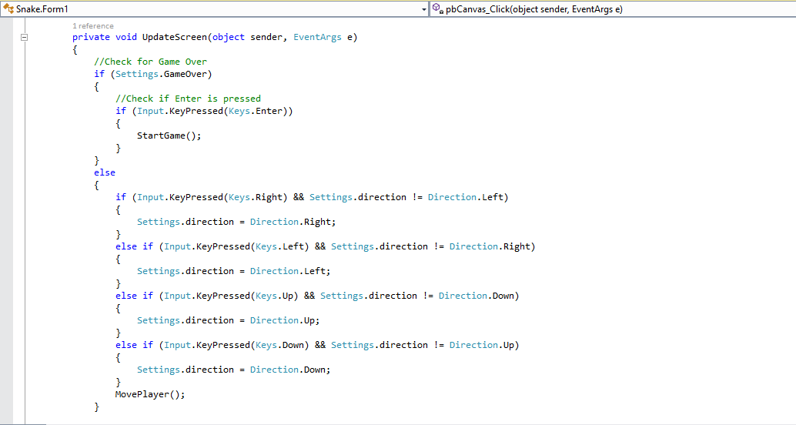

Slide 9
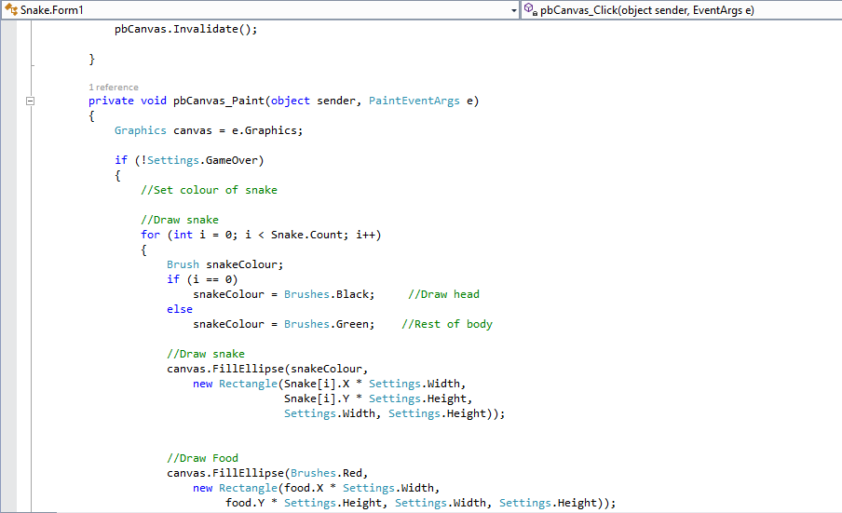

Slide 10
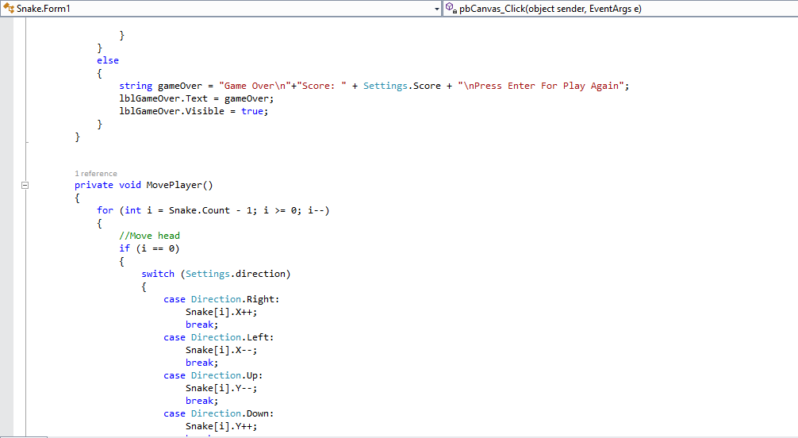

Slide 11
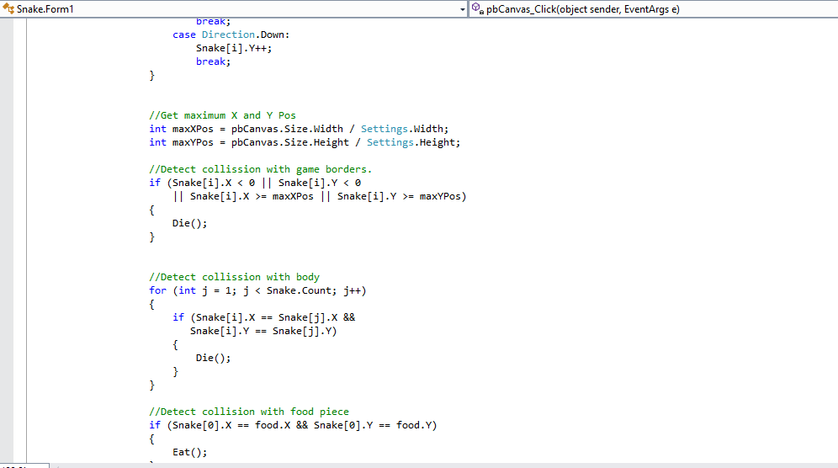

Slide 12
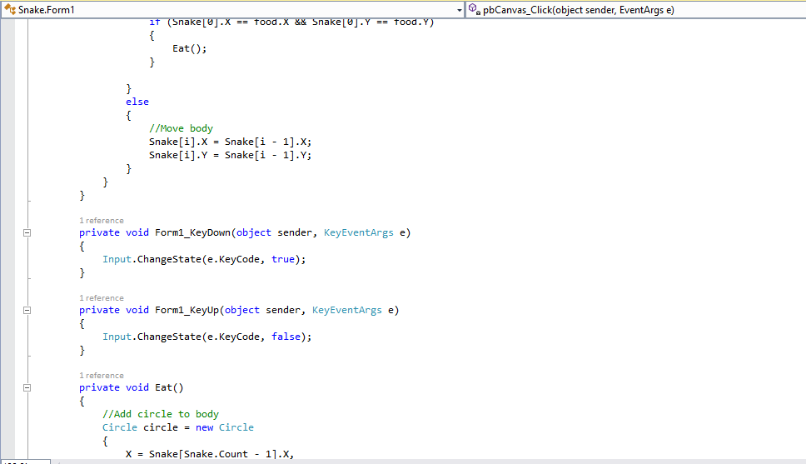

Slide 13
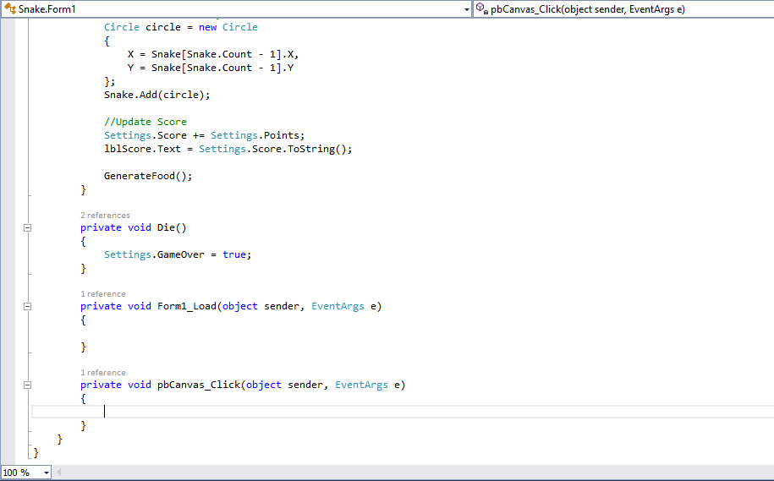

Slide 14
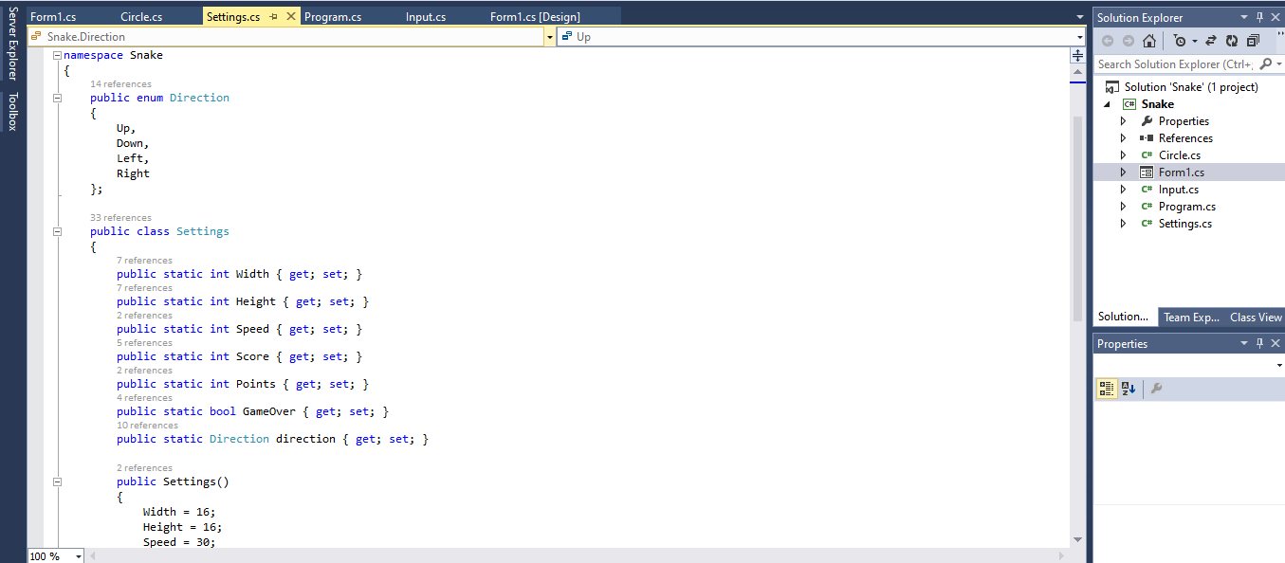

Slide 15
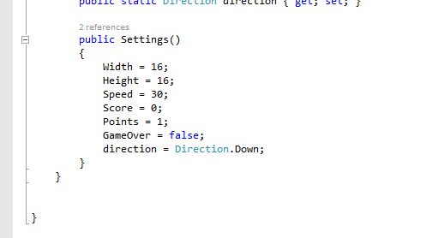

Slide 16
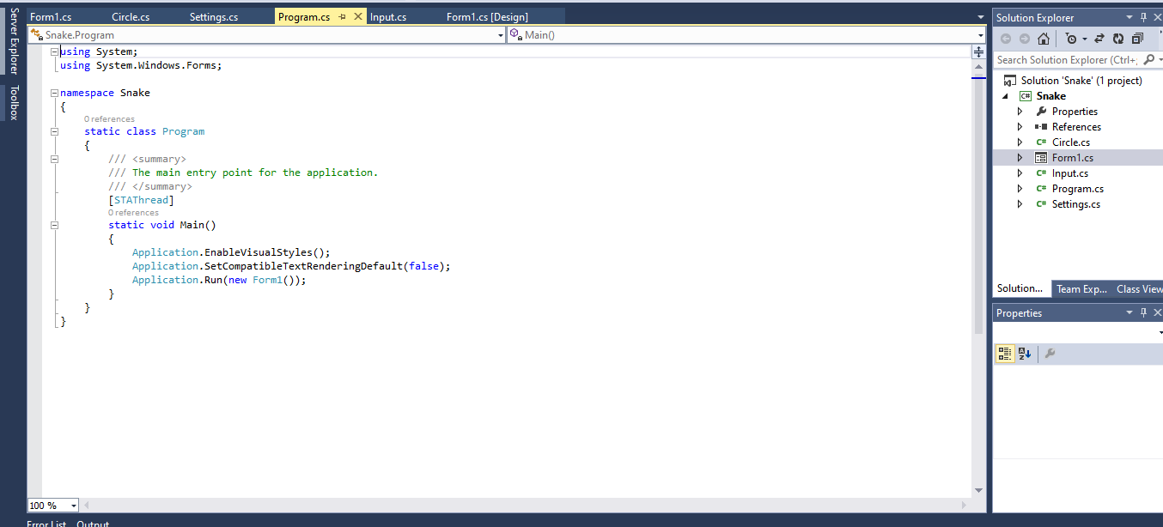

Slide 17
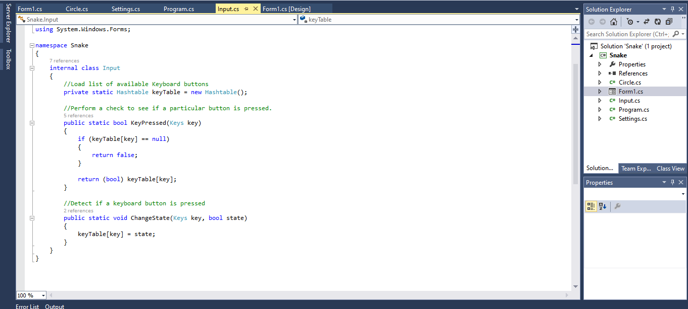

Slide 18
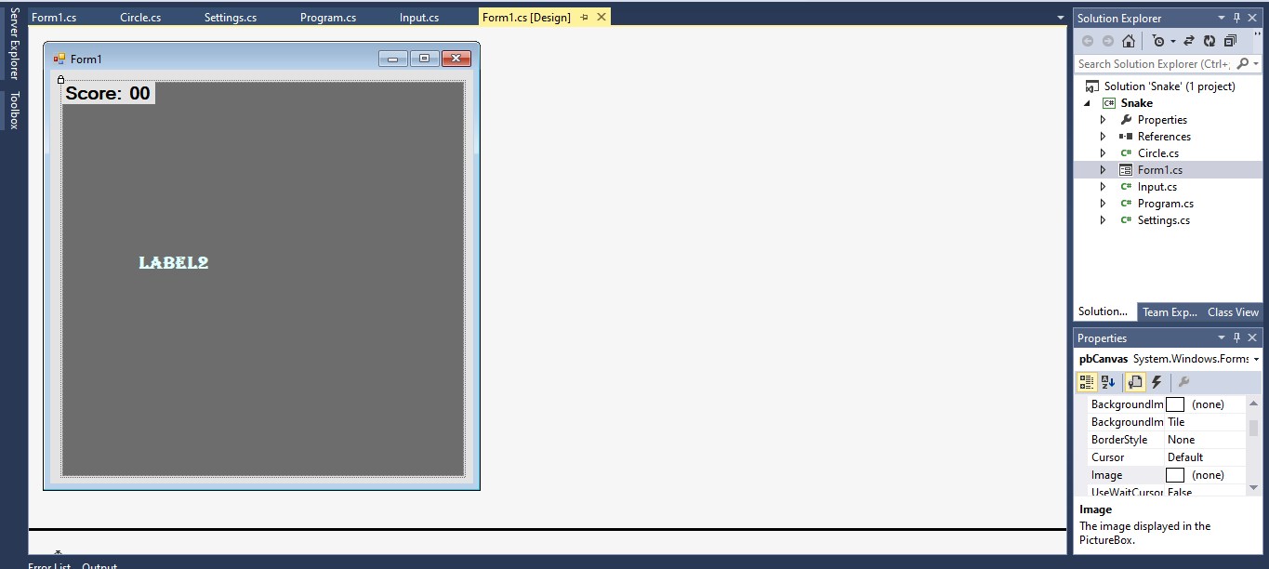

Slide 19
Future of project
Inhibited only by creativity and available technology
Use game for skills based trainings.
Important as learning point of view for children
Use for understand technology
Best for Education
Virtual Reality Gaming (FIFA)
Augmented Reality  Motion Capture

